Slide 1
Movie Recommender System by Gokilavani.RC
Source:
https://grouplens.org/datasets/movielens/latest
ReadMe:
http://files.grouplens.org/datasets/movielens/ml-latest-small-README.html

Slide 2

The dataset consists of 100,000 ratings and 3,600 tag applications applied to 9,000 movies by 600 users. (Last updated 9/2018)

Slide 3
What is a recommender system?
It is a machine learning prototype that learns how users’ choice of products (in this case movies) vary with the users characteristics and recommends a product accordingly.
For example a 15 year old kid is more likely to watch the upcoming The Lego Batman movie than someone who is say 35 years old.
A Recommender System employs a statistical algorithm that seeks to predict users' ratings for a particular entity, based on the similarity between the entities or similarity between the users that previously rated those entities.

Slide 4
Types of Recommender Systems
Simple recommender system
General recommendations based on movie attributes.
Content -based filtering
The basic idea is that if you like an item, then you will also
like a “similar” item
Collaborative filtering
It is based on the similarity in preferences, tastes and choice
of two users.
Hybrid recommendations
Combine any of the above two techninques

Slide 5
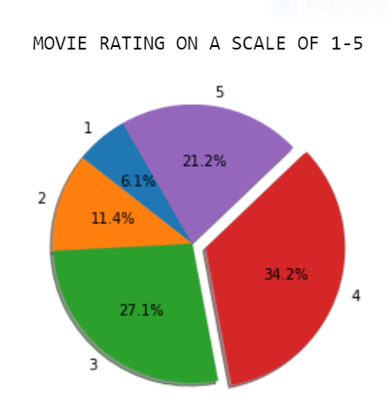

Slide 6
